Slide 1

7th Grade Accelerated Math
Unit 3, Lesson 3 Exponential Expressions Volume 1, pg. 112

Slide 2


Benchmark
MA.7.NSO.1.1
Know and apply the Laws of Exponents to evaluate numerical expressions and generate equivalent numerical expressions, limited to whole-number exponents and rational number bases.
volume 1, pg. 112

Slide 3
Integrated Mathematical Thinking and Reasoning Standards
MA.K12.MTR.1.1 Actively participate in effortful learning both individually and collectively.
MA.K12.MTR.3.1 Complete tasks with mathematical fluency.
MA.K12.MTR.4.1 Engage in discussions that reflect on the mathematical thinking of self and others.
MA.K12.MTR.5.1 Use patterns and structure to help understand and connect mathematical concepts.
MA.K12.MTR.6.1 Assess the reasonableness of solutions.
volume 1, pg. 112

Slide 4

Learning Targets
I can evaluate numeric expressions with the same base using the laws of exponents.
I can generate equivalent numeric expressions by applying the laws of exponents.
volume 1, pg. 112

Slide 5

Warm-Up
volume 1, pg. 112

Slide 6


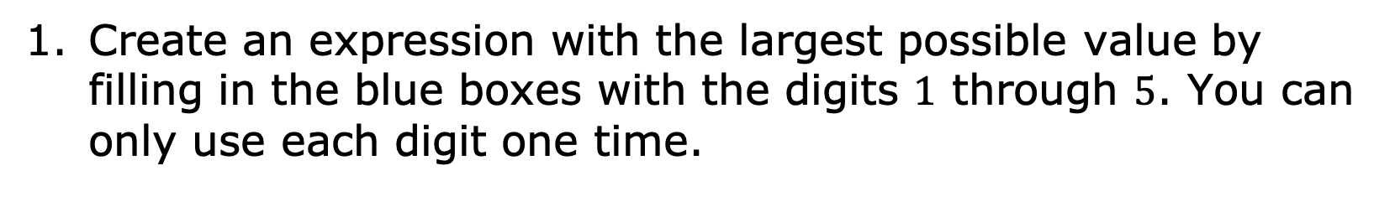
3.3.1 Warm-Up: Make an Expression
Create an expression with the largest possible value by filling in the blue boxes with the digits $1$ through $5$. You can only use each digit one time.
$$+$$
$$×$$
volume 1, pg. 112

Slide 7

Collaboration
volume 1, pg. 113

Slide 8

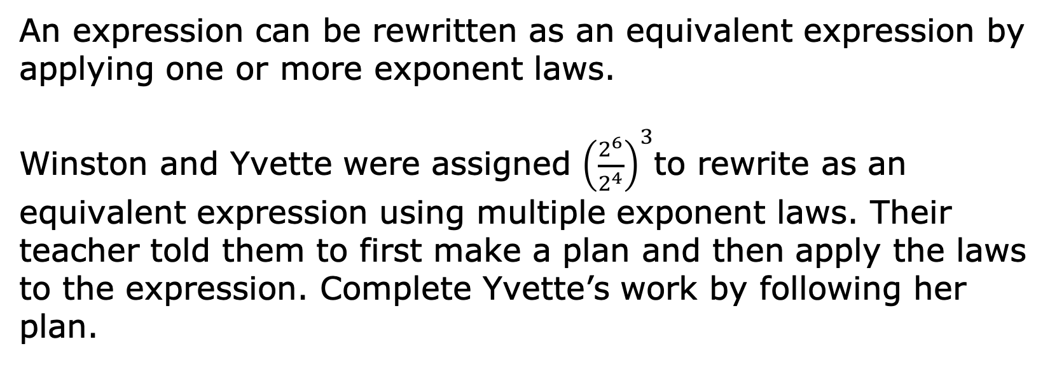
3.3.2 Collaboration: Applying More Than One Exponent Law
An expression can be rewritten as an equivalent expression by applying one or more exponent laws.
Winston and Yvette were assigned ${\left(\frac{2^{6}}{2^{4}}\right)}^{3}$to rewrite as an equivalent expression using multiple exponent laws. Their teacher told them to first make a plan and then apply the laws to the expression. Complete Yvette’s work by following her plan.
volume 1, pg. 113

Slide 9
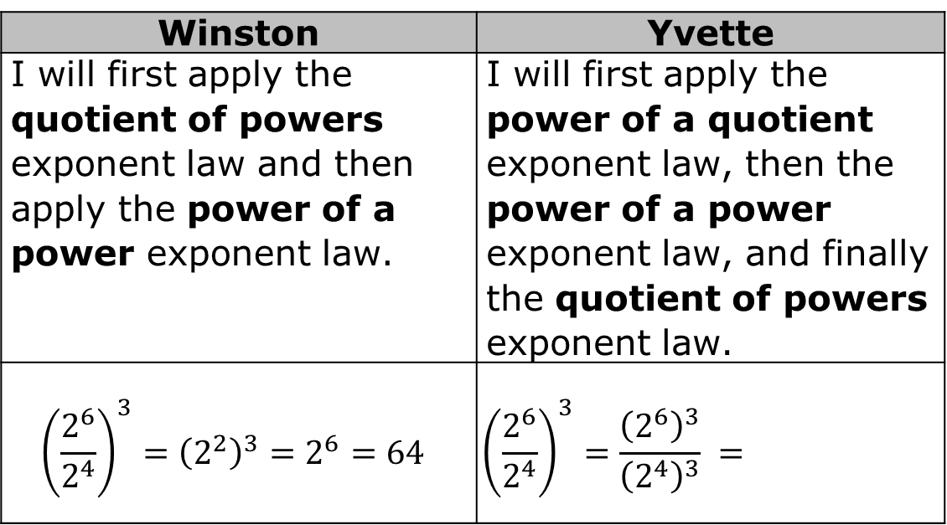
Winston | Yvette
I will first apply the quotient of powers exponent law and then apply the power of a power exponent law. | I will first apply the power of a quotient exponent law, then the power of a power exponent law, and finally the quotient of powers exponent law.
$${\left(\frac{2^{6}}{2^{4}}\right)}^{3}={\left(2^{2}\right)}^{3}=2^{6}=64$$ | $${\left(\frac{2^{6}}{2^{4}}\right)}^{3}=\frac{{\left(2^{6}\right)}^{3}}{{\left(2^{4}\right)}^{3}} =$$
volume 1, pg. 113

Slide 10
Explain which method you prefer.
Ask your partner which method they prefer. Write their explanation here.
volume 1, pg. 113

Slide 11

Guided Practice
volume 1, pg. 113

Slide 12

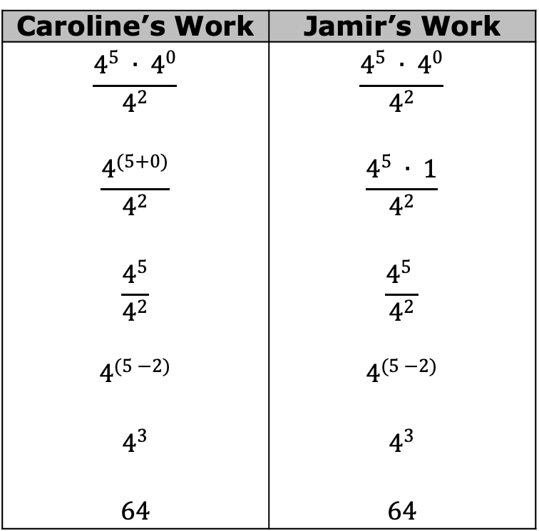
3.3.3 Guided Practice: Writing Equivalent Expressions to Evaluate
Two students evaluated the expression $\frac{4^{5} ∙ 4^{0}}{4^{2}}$ and found its value.
Caroline’s Work | Jamir’s Work
$$\frac{4^{5} ∙ 4^{0}}{4^{2}}$$ $$\frac{4^{(5+0)}}{4^{2}}$$ $$\frac{4^{5}}{4^{2}}$$ $$4^{(5 −2)}$$ $$4^{3}$$ $$64$$ | $$\frac{4^{5} ∙ 4^{0}}{4^{2}}$$ $$\frac{4^{5} ∙ 1}{4^{2}}$$ $$\frac{4^{5} }{4^{2}}$$ $$4^{(5 −2)}$$ $$4^{3}$$ $$64$$
volume 1, pg. 113

Slide 13
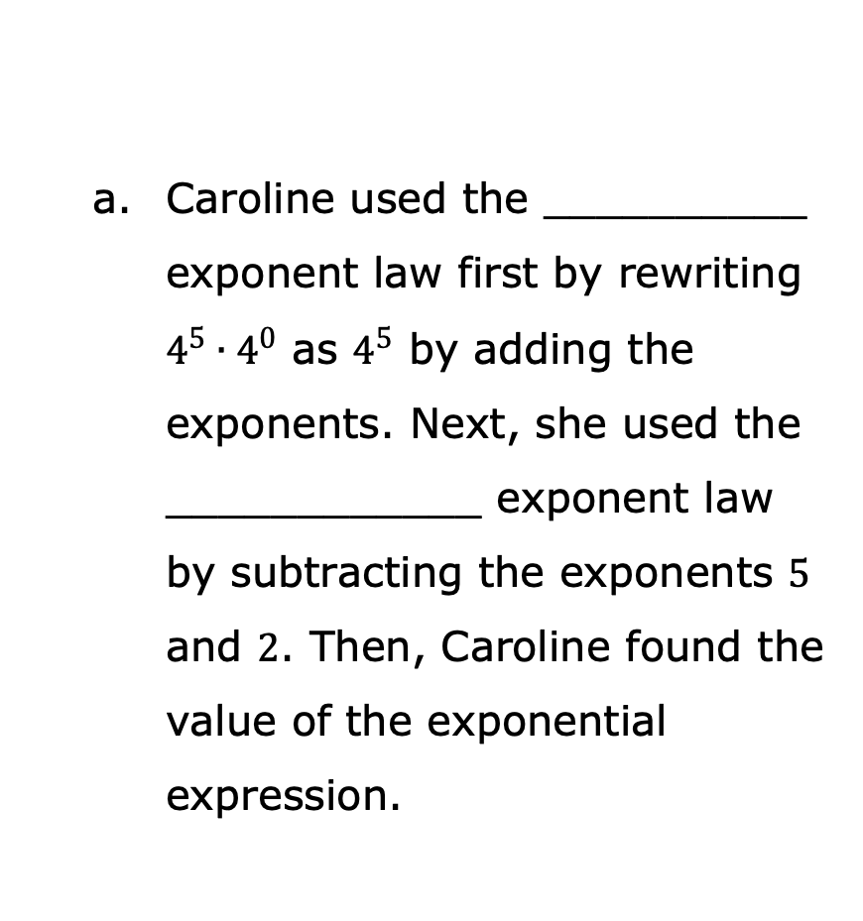
Caroline used the __________ exponent law first by rewriting $4^{5}∙4^{0}$ as $4^{5}$ by adding the exponents. Next, she used the ____________ exponent law by subtracting the exponents $5$ and $2$. Then, Caroline found the value of the exponential expression.
Complete the statements explaining each student’s work by using the phrases from the word bank.
zero
identity
power of a power
product of powers
power of a product
quotient of powers
power of a quotient
volume 1, pg. 113

Slide 14
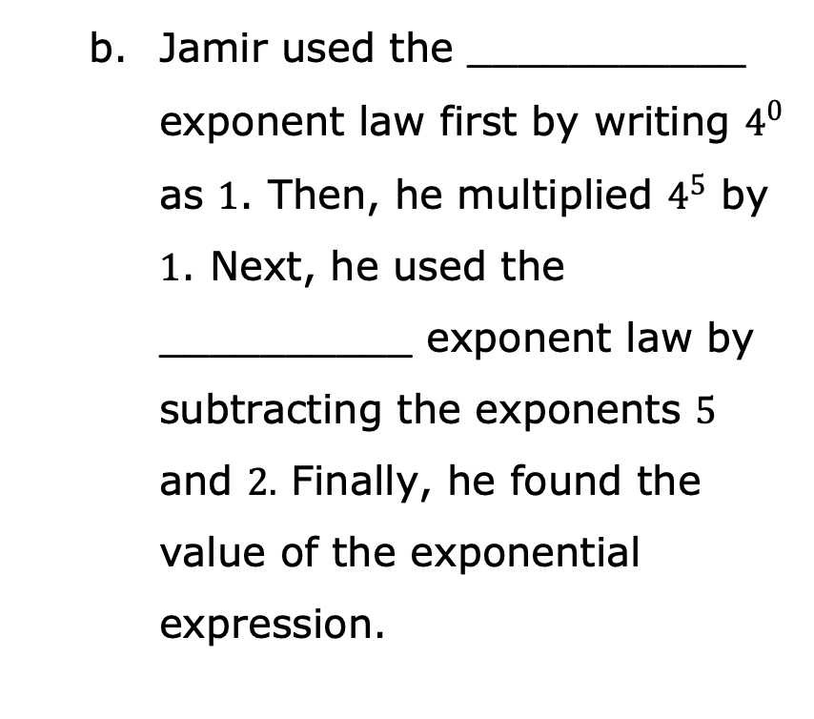
Jamir used the ___________ exponent law first by writing $4^{0}$ as $1$. Then, he multiplied $4^{5}$ by $1$. Next, he used the __________ exponent law by subtracting the exponents $5$ and $2.$ Finally, he found the value of the exponential expression.
zero
identity
power of a power
product of powers
power of a product
quotient of powers
power of a quotient
volume 1, pg. 114

Slide 15
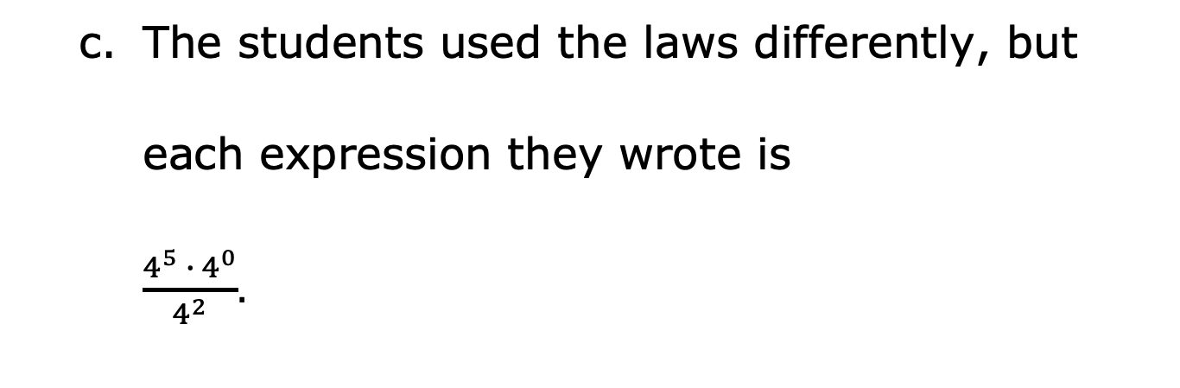
The students used the laws differently, but
each expression they wrote is
$\frac{4^{5} ∙ 4^{0}}{4^{2}}$.
less than
equivalent to
greater than
volume 1, pg. 114

Slide 16
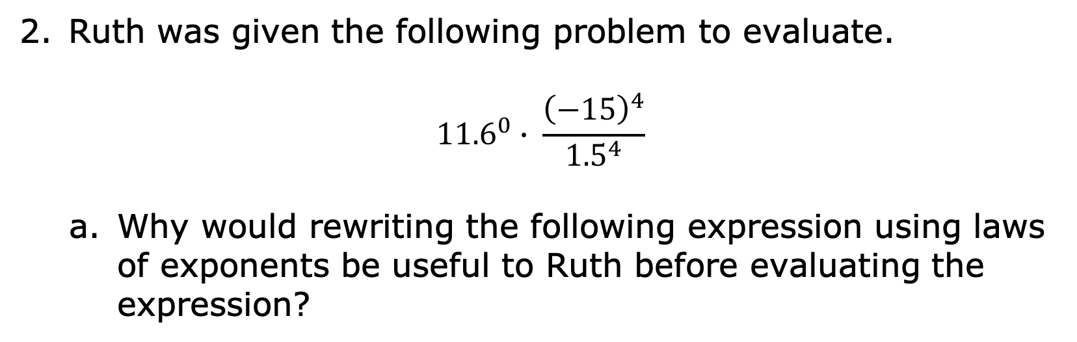
Ruth was given the following problem to evaluate.
$${11.6}^{0}∙ \frac{{\left(−15\right)}^{4}}{{1.5}^{4}}$$
Why would rewriting the following expression using laws of exponents be useful to Ruth before evaluating the expression?
volume 1, pg. 114

Slide 17
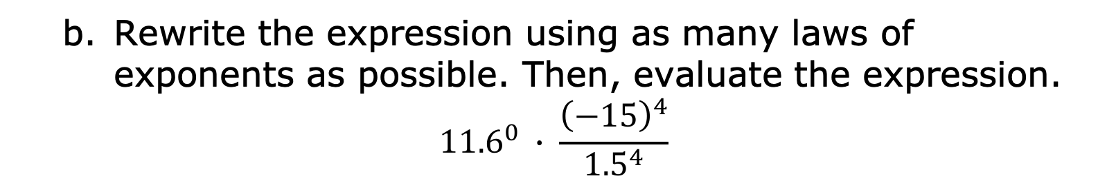
Rewrite the expression using as many laws of exponents as possible. Then, evaluate the expression.
$${11.6}^{0} ∙ \frac{{\left(−15\right)}^{4}}{{1.5}^{4}}$$
volume 1, pg. 114

Slide 18

Activity
volume 1, pg. 115

Slide 19

3.3.4 Activity: Roundtable
In teams of three, assign a number to each team member. Each student completes the first step of their problem and writes the exponent law used. Then, pass your problem to the student on your right to check your work and write the next step to the problem. For each new step, continue passing the problems to the student on your right until all three problems are evaluated.
volume 1, pg. 115

Slide 20
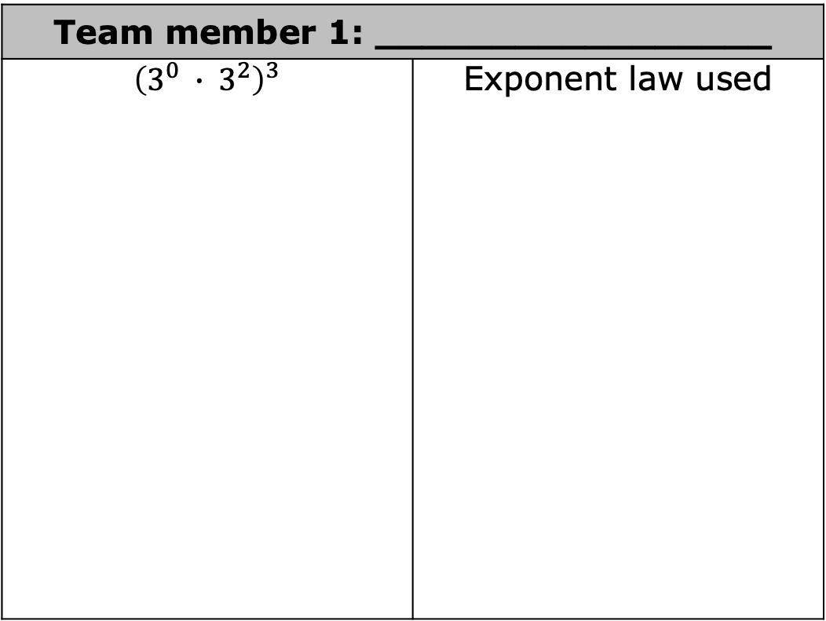
Team member 1: _________________
$${\left(3^{0} ∙ 3^{2}\right)}^{3}$$ | Exponent law used
volume 1, pg. 115

Slide 21
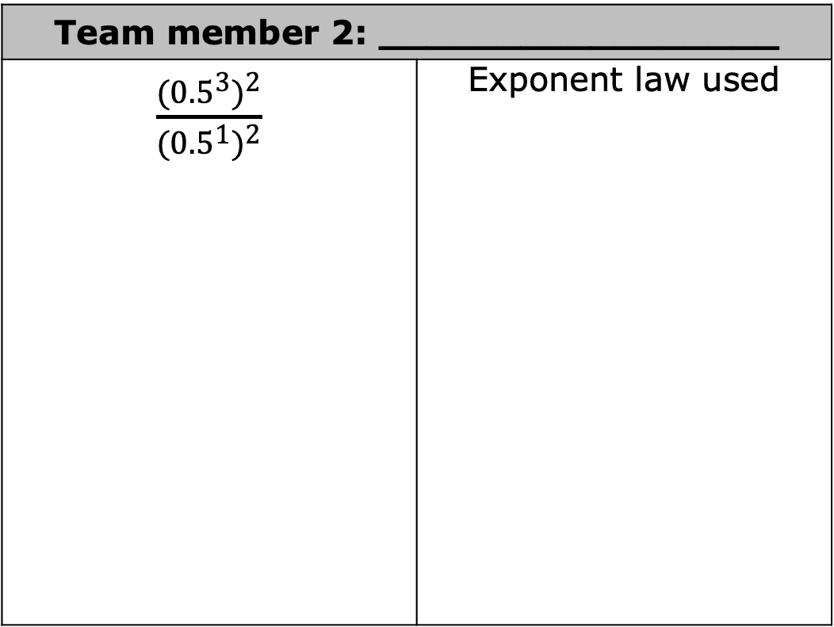
Team member 2: _________________
$\frac{{({0.5}^{3})}^{2}}{{({0.5}^{1})}^{2}}$ | Exponent law used
volume 1, pg. 115

Slide 22
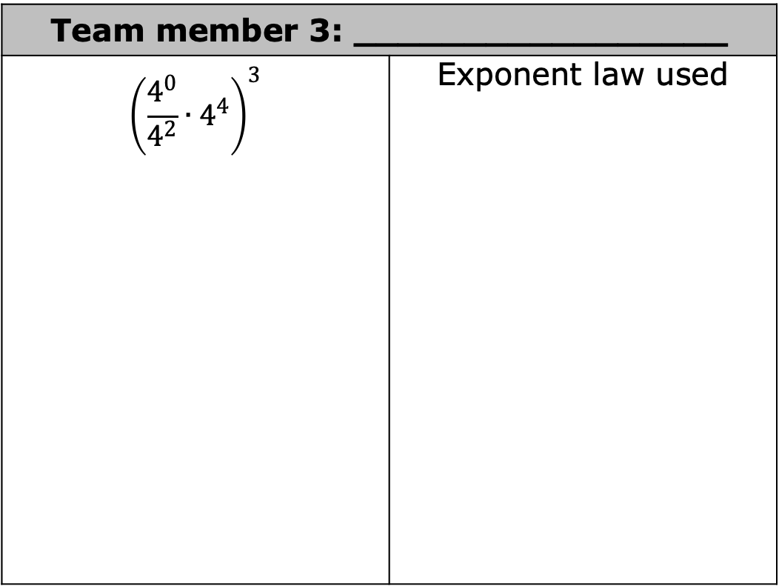
Team member 3: _________________
$${\left(\frac{4^{0}}{4^{2}}∙4^{4}\right)}^{3}$$ | Exponent law used
volume 1, pg. 115

Slide 23

Your Turn
volume 1, pg. 116

Slide 24
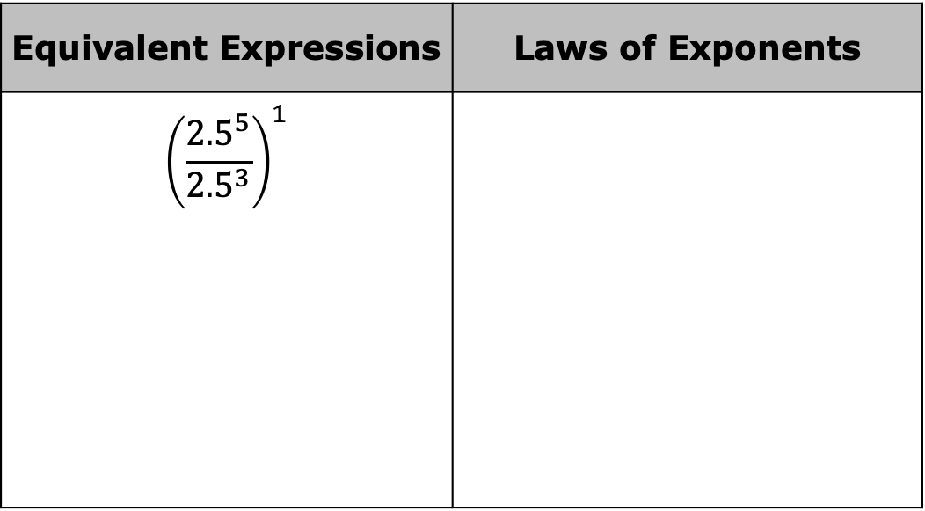
3.3.5 Your Turn!
Use the laws of exponents to evaluate the expressions. Record the law used at each step.
Equivalent Expressions | Laws of Exponents
$${\left(\frac{{2.5}^{5}}{{2.5}^{3}}\right)}^{1}$$
volume 1, pg. 116

Slide 25

Equivalent Expressions | Laws of Exponents
$${\left[{\left(\frac{2}{3}\right)}^{0} ∙ {\left(\frac{2}{3}\right)}^{2}\right]}^{3}$$
volume 1, pg. 116

Slide 26

Equivalent Expressions | Laws of Exponents
$$\frac{{0.5}^{3}}{{2.5}^{3}} ∙ {\left(\frac{0.5}{2.5}\right)}^{2}$$
volume 1, pg. 116

Slide 27
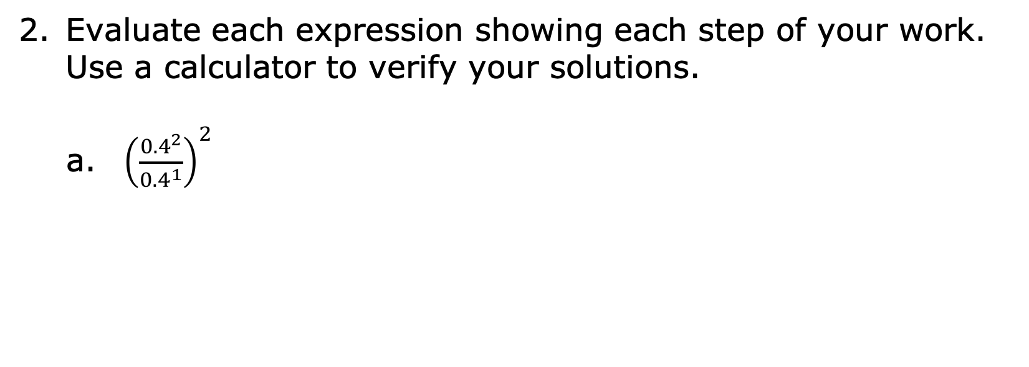
Evaluate each expression showing each step of your work. Use a calculator to verify your solutions.
${\left(\frac{{0.4}^{2}}{{0.4}^{1}}\right)}^{2}$
volume 1, pg. 116

Slide 28

$\frac{{\left(2^{2} ∙ {3.2}^{0}\right)}^{6}}{2^{10}}$
$\frac{{\left(−4\right)}^{2} ∙ {\left(−4\right)}^{1}}{{\left(−4\right)}^{0}}$
volume 1, pg. 116

Slide 29
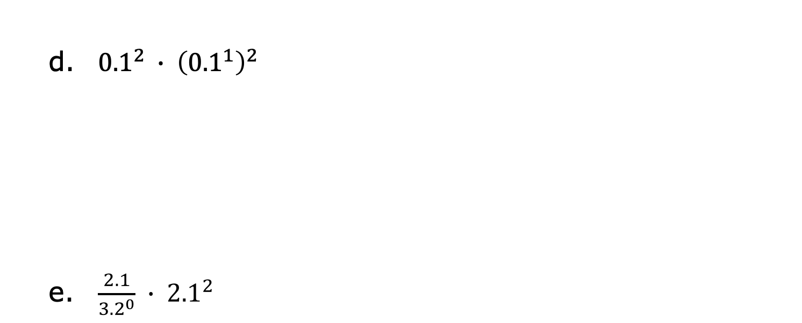
${0.1}^{2} ∙ {\left({0.1}^{1}\right)}^{2}$
$\frac{2.1}{{3.2}^{0}} ∙ {2.1}^{2}$
volume 1, pg. 116

Slide 30

Wrap-Up
volume 1, pg. 117

Slide 31
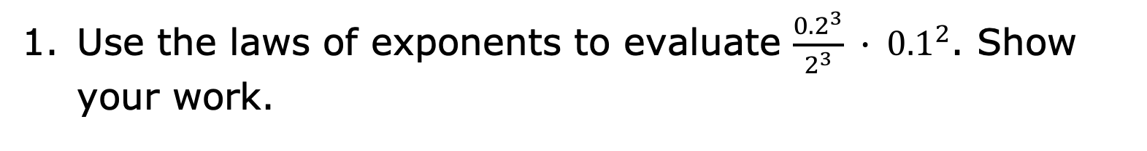
3.3.6 Wrap-Up: Ticket Out the Door
Use the laws of exponents to evaluate $\frac{{0.2}^{3}}{2^{3}} ∙ {0.1}^{2}$. Show your work.
volume 1, pg. 117

Slide 32

Select all of the expressions equivalent to $\frac{{0.2}^{3}}{2^{3}} ∙ {0.1}^{2}$.
${0.1}^{5}$
${0.2}^{0} ∙ {0.1}^{2}$
${0.1}^{3} ∙ {0.1}^{2}$
$\frac{{0.2}^{5}}{{0.2}^{3}}$
${\left(\frac{0.2}{2}\right)}^{3}∙ {0.1}^{2}$
${0.2}^{5}$
volume 1, pg. 117

